Slide 1

BIM460 Software Modeling
Mustafa CALIK

Slide 2


Attach additional responsibilities to an object dynamically. Decorators provide a flexible alternative to subclassing for extending functionality.
Wrapper

Slide 3

Sometimes we want to add responsibilities to individual objects, not to an entire class. For example, you want add properties such as borders or scrollbars to a GUI component.
We can do this with inheritance (subclassing), but this limits our flexibility.

Slide 4

A flexible approach is to enclose the component in another object that adds the functionality. The object is the decorator.
Decorator adds functionality to objects dynamically.
The decorator class is transparent to component’s clients.
Transparency allows an unlimited number of added responsibilities.

Slide 5

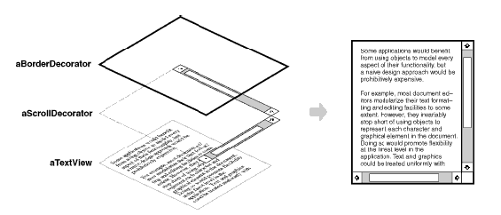
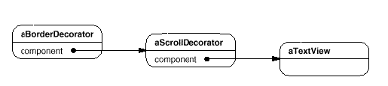

Slide 6

Use Decorator:
  To add responsibilities to individual objects dynamically without affecting other objects.
  For responsibilities that can be withdrawn.
  When extension by subclassing is impractical. Sometimes a large number of independent extensions are possible and would produce an explosion of subclasses to support every combination.

Slide 7

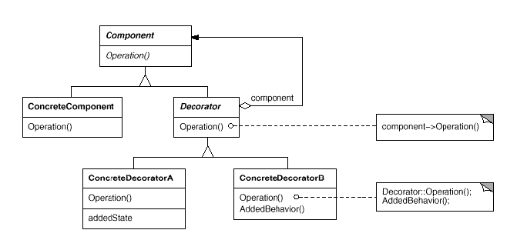

Slide 8

Component:
defines the interface for objects that can have responsibilities added to them dynamically.
ConcreteComponent:
defines an object to which additional responsibilities can be attached.
Decorator:
maintains a reference to a Component object and defines an interface that conforms to Component's interface.
ConcreteDecorator:
  adds responsibilities to the component.

Slide 9

Pro’s
More flexible than static inheritance
    • allows to mix and match responsibilities
    • allows to apply a property twice
Avoids feature laden classes high up in hierarchy
    • "pay-as-you-go" approach: define a simple class and add
    functionality incrementally with decorators
    • easy to define new types of decorations, independently from
    the classes they decorate
Con’s
A decorator and its component aren't identical
    • checking object identification can cause problems
    – e.g. if ( aComponent instanceof TextView )
Lots of little objects
    • easy to customize, but hard to learn and debug

Slide 10

Several issues should be considered when applying the Decorator pattern:
Interface conformance:
A decorator object's interface must conform to the interface of the component it decorates.
Omitting the abstract Decorator class:
There's no need to define an abstract Decorator class when you only need to add one responsibility.
Keeping Component classes light weight:
Component class should be dedicated to defining an interface, no other functions. Keep it light and simple. A complex Component class might make Decorator too costly to use in quantity.
Changing the skin of an object versus its guts:
We can think of a decorator as a skin over an object that changes its behavior. An alternative is to change the object's guts. The Strategy pattern is a good example of a pattern for changing the guts.

Slide 11

Suppose there is a TextView GUI component and you want to add borders and/or scrollbars to it.
Currently, there are three types of borders
  Plain, 3D, Fancy
And three scrollbars
  Horizontal, Vertical, Both

Slide 12

Solution 1: Let’s use inheritance first. We’ll generate subclasses of TextView for all the required cases. We’ll need the 15 subclasses:
e.g. TextViewWithNoBorder&SideScrollbar,
      TextViewWithNoBorder&BottomScrollbar,
    TextViewWithNoBorder&Bottom&SideScrollbar, TextViewWith3DBorder,
    TextViewWith3DBorder&SideScrollbar, TextViewWith3DBorder&BottomScrollbar,
    TextViewWith3DBorder&Bottom&SideScrollbar, ... .....

Slide 13
There are several disadvantages to this technique:
  We already have an explosion of subclasses. What if we add another type of border? Or an entirely different property?
  We have to instantiate a specific subclass to get the behavior we want. This choice is made statically and a client can't control how and when to decorate the component.

Slide 14

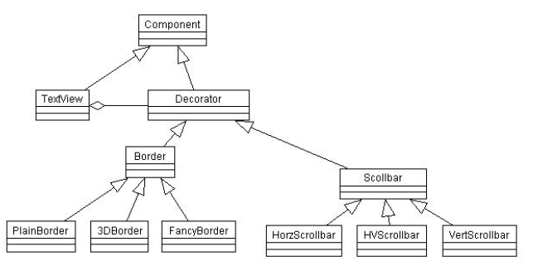
Solution 2:Let’s use the Strategy pattern!

Slide 15
Now the TextView Class looks like this:
  public class TextView extends Component {
  private Border border;
  private Scrollbar sb;
  public TextView(Border border, Scrollbar sb) {
  this.border = border;
  this.sb = sb;
  }
  public void draw() {
  border.draw();
  sb.draw();
  // Code to draw the TextView object itself.
  }
  }

Slide 16
Using the Strategy pattern we can add or change properties to the TextView component dynamically. For example, we could have mutators for the border and sb attributes and we could change them at run-time.
But note that the TextView object itself had to be modified and it has knowledge of borders and scrollbars! If we wanted to add another kind of property or behavior, we would have to again modify TextView.

Slide 17

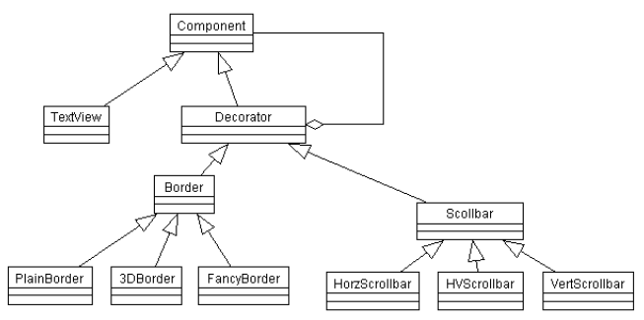
Solution 3: Let’s turn Strategy inside out to get the Decorator pattern!

Slide 18

Examples in Java:
  multilayered input streams adding useful I/O methods
  adding designs, scroll bars and borders to GUI controls
Normal InputStream class has only public int read() method to read one letter at a time. Decorators such as BufferedReader or Scanner add additional functionality to read the stream more easily
  // InputStreamReader/BufferedReader decorate InputStream
  InputStream in = new FileInputStream("hardcode.txt");
  InputStreamReader isr = new InputStreamReader(in);
  BufferedReader br = new BufferedReader(isr);
  // because of decorator streams, I can read an
  // entire line from the file in one call
  // (InputStream only provides public int read() )
  String wholeLine = br.readLine();

Slide 19

Adapter:
  A decorator is different from an adapter in that a decorator only changes an object's responsibilities, not its interface; an adapter will give an object a completely new interface.
Composite:
  A decorator can be viewed as a degenerate composite with only one component. However, a decorator adds additional responsibilities—it isn't intended for object aggregation.
Strategy:
  A decorator lets you change the skin of an object; a strategy lets you change the guts. These are two alternative ways of changing an object.

Slide 20

References:
  Erich Gamma, Richard Helm, Ralph Johnson, John Vlissides. Design Patterns: Elements of Reusable Object-Oriented Software.
  http://tasarimdesenleri.wordpress.com/2009/09/15/
  http://www.cintegrity.com/content/%E2%80%9CGang-Four%E2%80%9D-Decorator-Pattern-What-Its-Appropriate-Use?page=6

